Slide 1




Welcome to
Notes:
Today we are going to explore a new wellbeing program called Pulse.

Slide 2

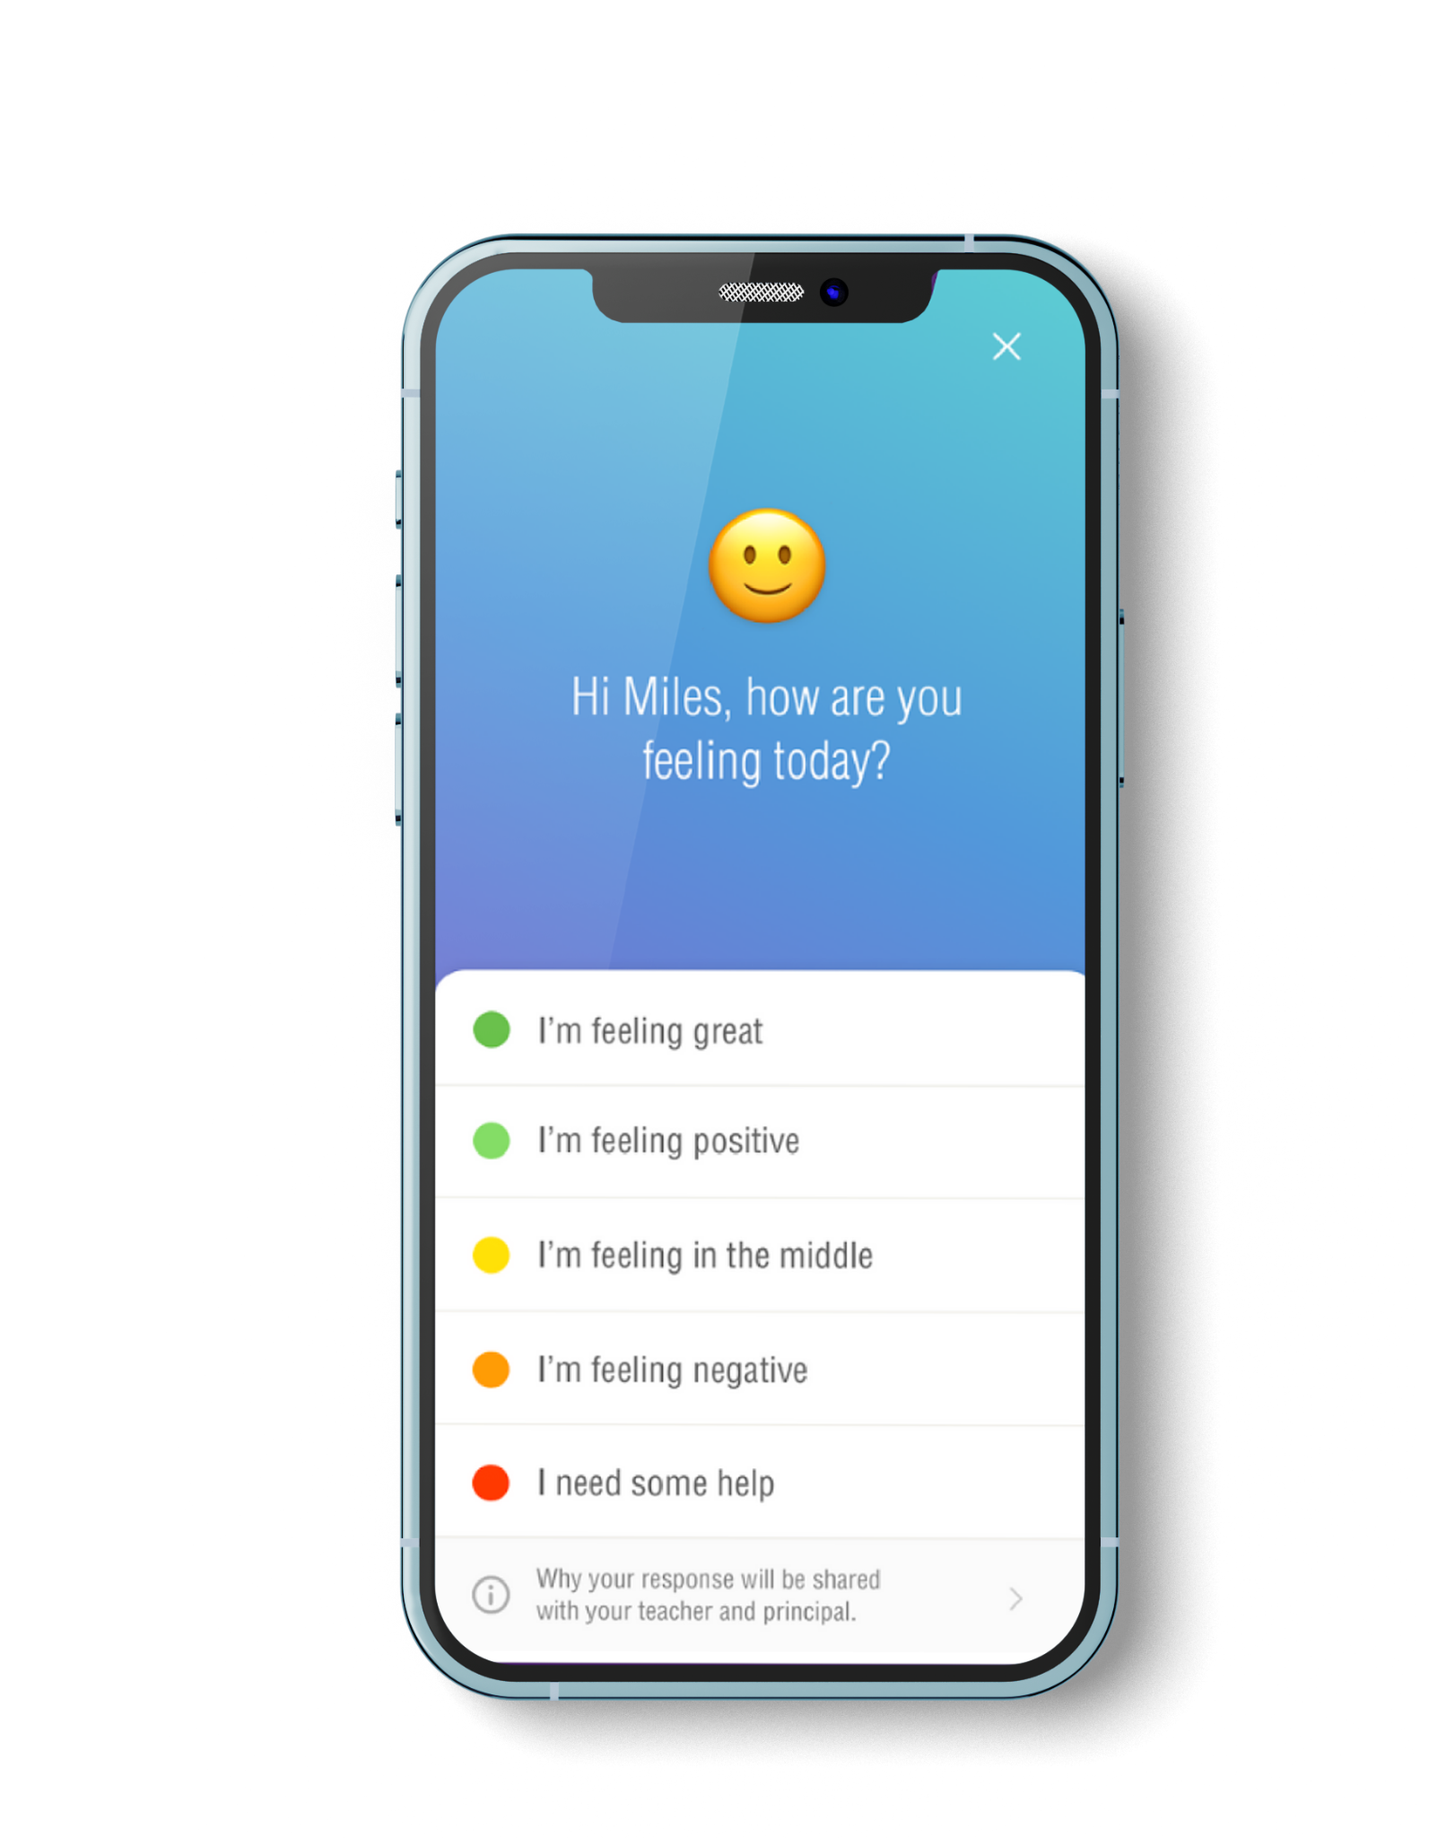
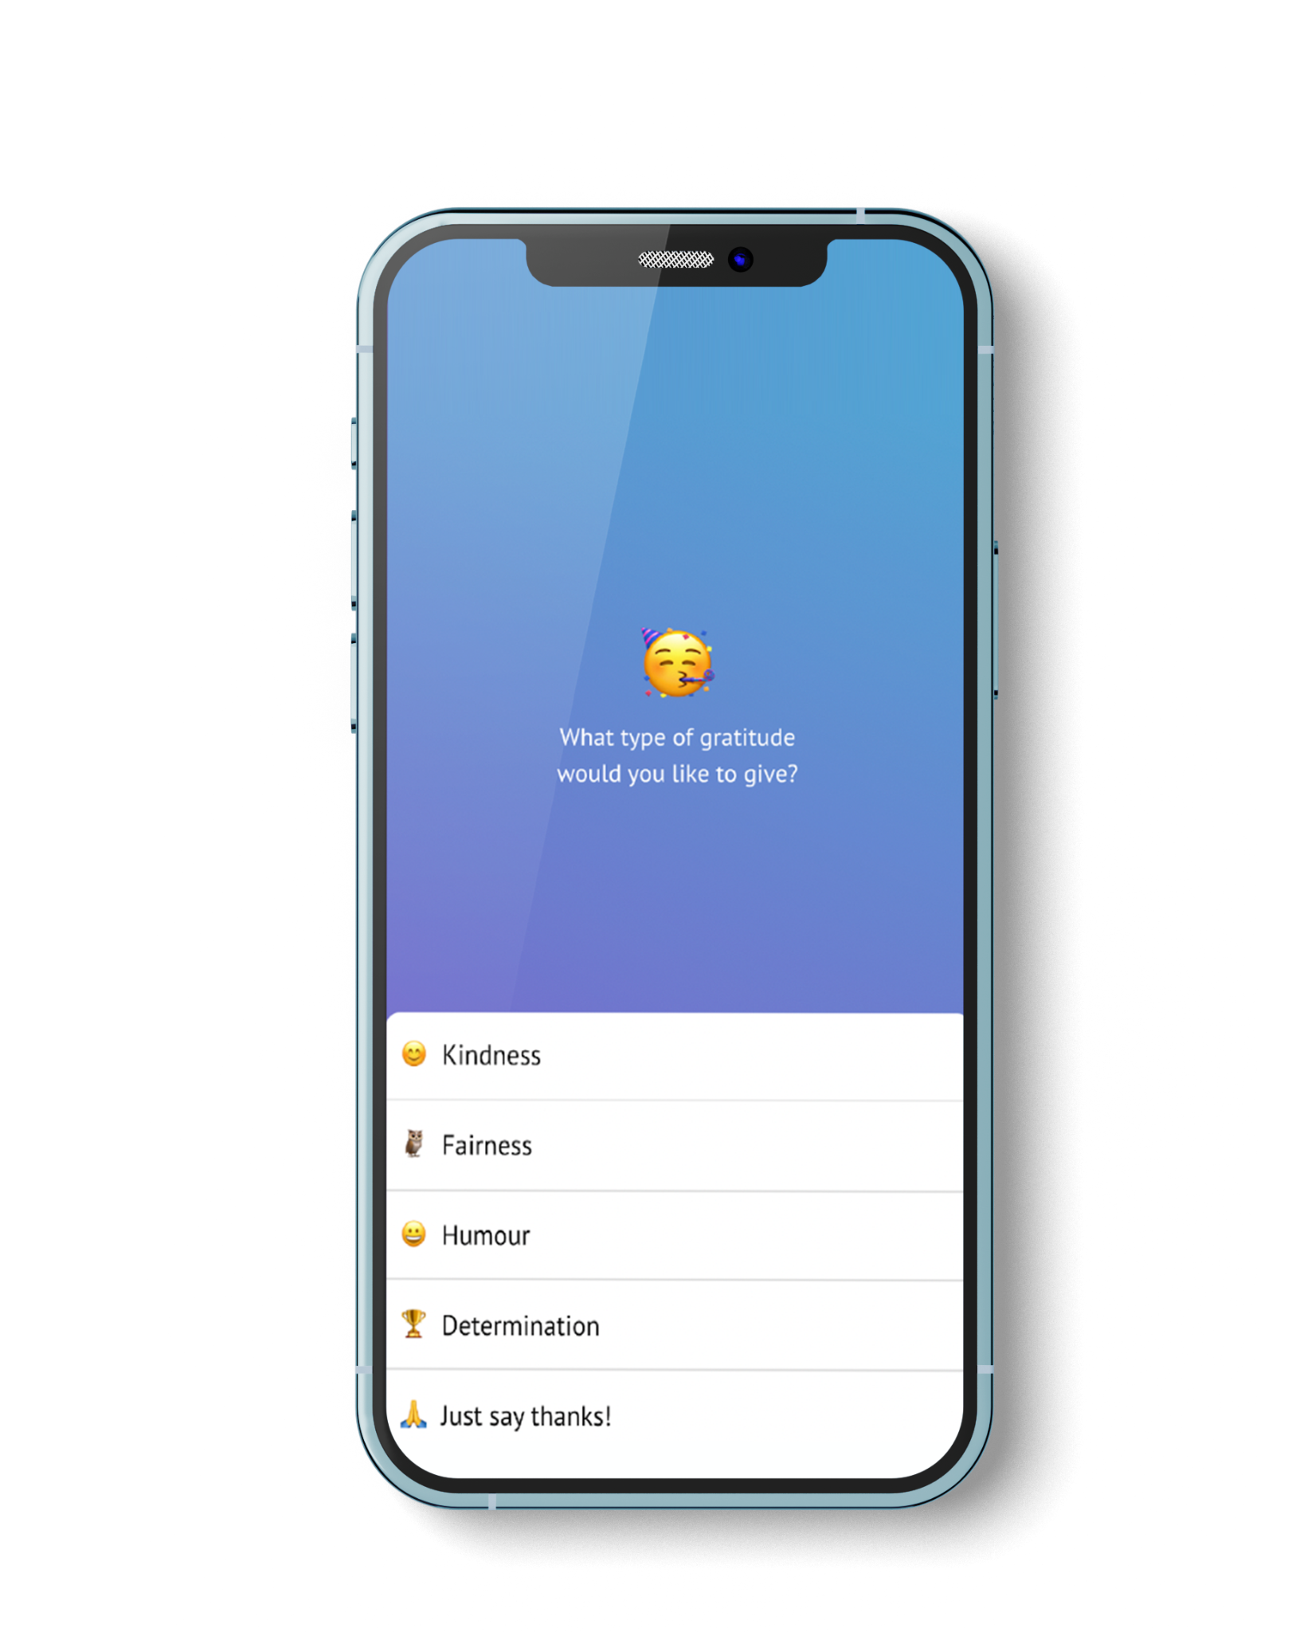
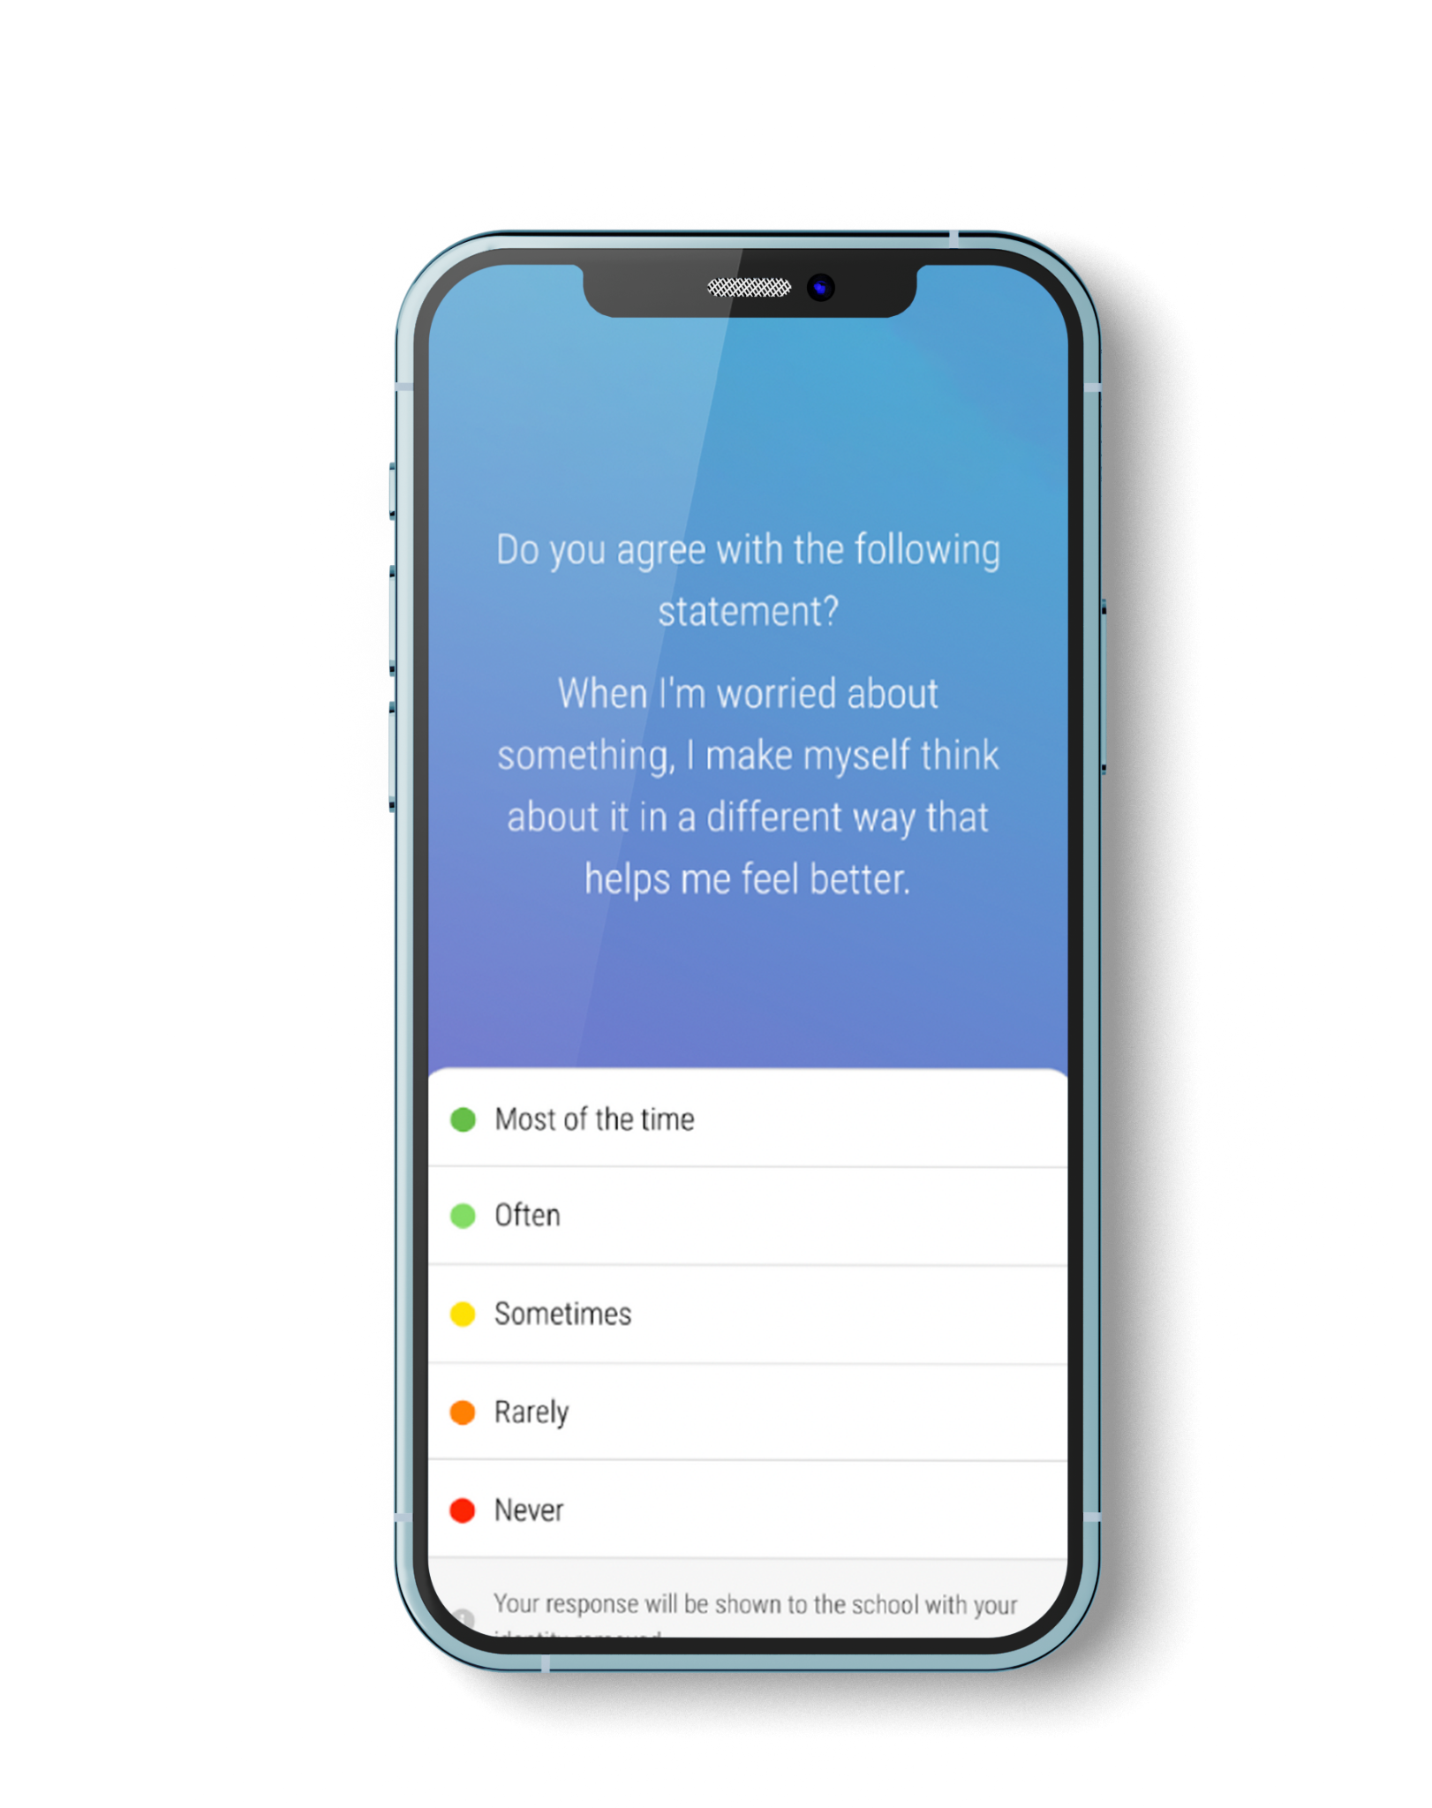


What is Pulse?
Pulse is an app you can use to check in with your mental, social and physical wellbeing
It takes 60 seconds, once a week.
You can reach out for help
You can send thanks to staff or peers
Give anonymous feedback about your experience at school
Smoothwall.com/pulse
Notes:
Pulse is an app you can use to check in with your mental, social and physical wellbeing
It takes 60 seconds, once a week
You can reach out for help
You can send thanks to staff or peers
Give anonymous feedback about your experience at school [important: ensure that students are aware that this data is anonymised, and that it is used to gather a broad picture of the school experience so that school leaders can make changes accordingly, where necessary]

Slide 3

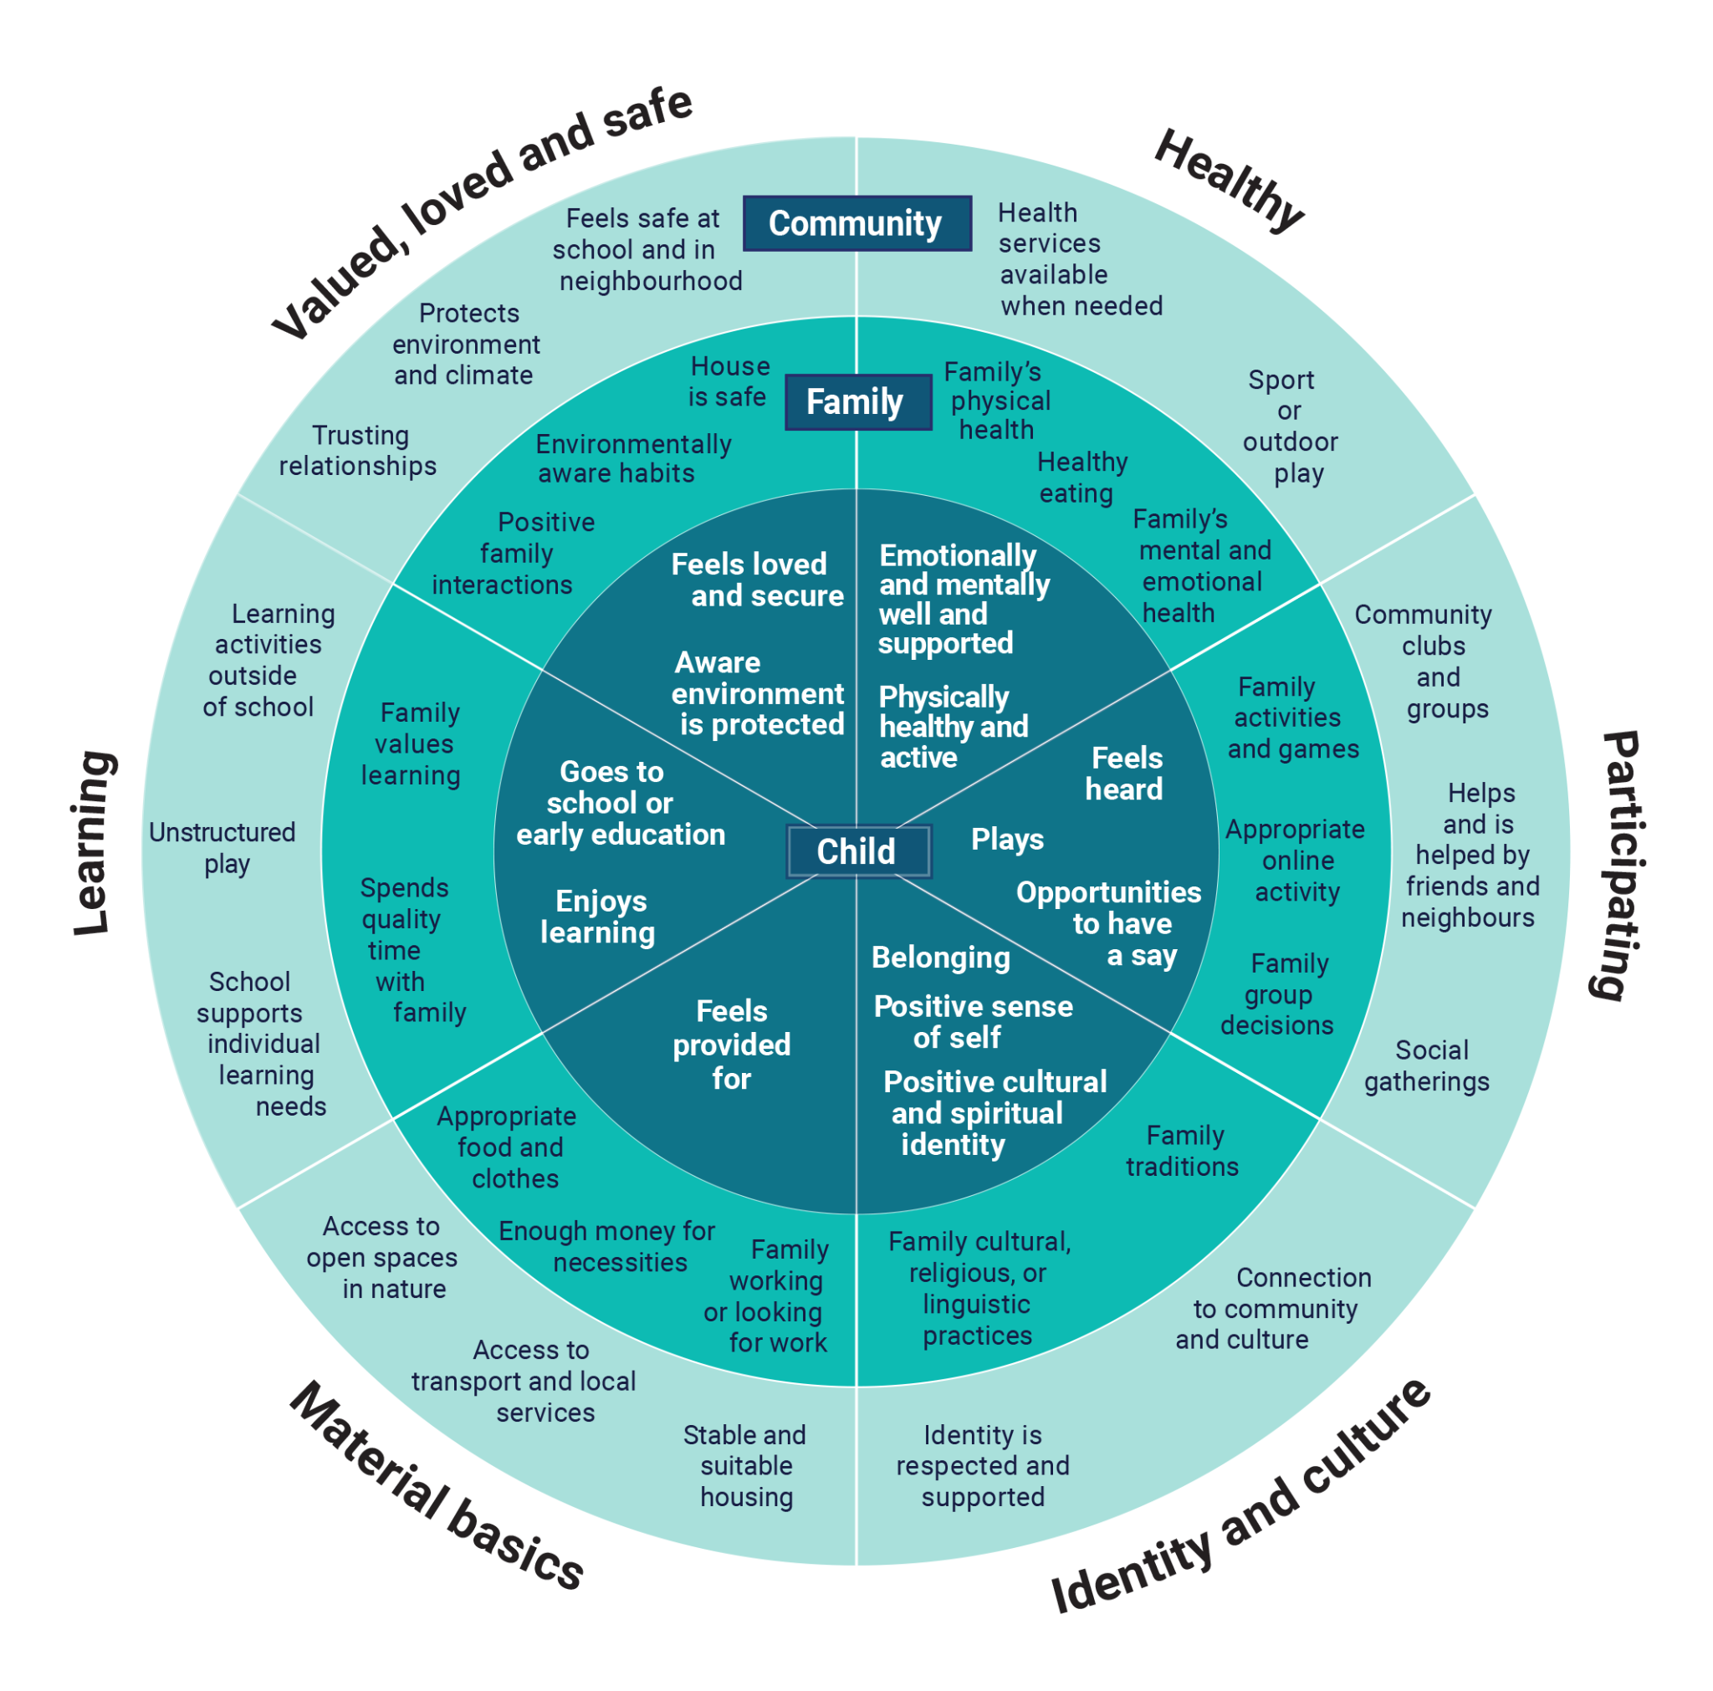

What is Wellbeing?
Smoothwall.com/pulse
Smoothwall.com/pulse
Smoothwall.com/pulse
Notes:
Wellbeing is a cover all term that encompasses these six domains. It’s important to recognize that to have optimal wellbeing, we need to be adequately resourced in all six domains.
Explore the ARACY wellbeing wheel with students.
Healthy: The overall physical, mental and emotional health of students.
Material Basics: The basic parts of life that contribute to an overall well-rounded individual.
Valued and Safe: How valued and safe a student feels.
Participating: How a student participates in the activities and relationships around them.
Learning: How a student learns.
Positive Sense of Culture and Identity: How a student feels they belong within the school academic and social environment and the expectation they perceive to be placed on them.

Slide 4

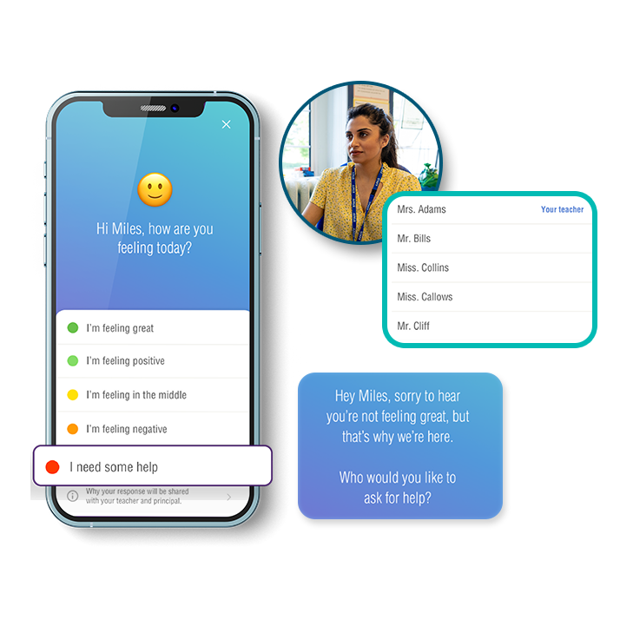
How does Pulse work?
Smoothwall.com/pulse
Notes:
I’ll now take you through the practicalities of the system.
Pulse allows students to complete quick and easy wellbeing check-ins.
We will all check in at the same time each week
You will receive an email prompting them to check in at the same time each week (for our school, this is on **Day/TIme**)
Students who have not completed a check-in for the week will also receive a reminder email on **Day/Time**

Slide 5
The big question
Smoothwall.com/pulse
Notes:
The first question is ‘How are you feeling today?’
Only the teachers who are directly responsible for your wellbeing will be able to see how you respond to this question
Next lesson, we are going to do an activity to explore how to identify our feelings

Slide 6
What if you ask for help?
You can choose who you would like
to speak to
Staff members are notified by an email
They will approach you discreetly
Smoothwall.com/pulse
Notes:
If you choose the option that says I need some help, you will be given a choice of who you would like to speak to at your school. They will then be notified by email and will approach you discreetly.

Slide 7

Up next..
Smoothwall.com/pulse
Notes:
Once you have answered the big question, you will answer five anonymous questions such as the one on the screen. Theses answers are kept anonymous so that you can feel free to answer completely honestly, and give real feedback about the culture and workings of the school.

Slide 8
Finally
Smoothwall.com/pulse
Notes:
At the end of the check-in, you will have the opportunity to share some gratitude with a friend or staff member.

Slide 9


Why bother?
Smoothwall.com/pulse
Notes:
I can imagine that some of you are thinking to yourselves that this just going to be another thing to worry about

Slide 10




Pulse helps you to:
Self Reflect
Connect with
Support
Have a voice
Smoothwall.com/pulse
Notes:
It will give you a safe way to ask for help if you need it, as well as a new way to make your voice heard and give us your opinion on your experience at school. As staff, we are going to take the information we gather seriously in order to make meaningful changes where necessary.

Slide 11

Thank you
For any questions please contact:
Form Tutor
Director of Key Stage
Mrs Gilton
Smoothwall.com/pulse

